Slide 1
Workshop
Overview
Module 1: Overview of the Microsoft Azure Platform
Module 2: Building Application Infrastructure in Azure
Module 3: Hosting Web Applications on the Azure Platform
Module 4: Storing SQL Data in Azure
Module 5: Designing a Communication Strategy by Using Queues and Service Bus

Slide 2
Module 4:
Storing SQL Data in Azure

Slide 3
Module 4 Overview
Lesson 1, Azure SQL Database Overview, describes the Azure SQL Database service and reasons you would consider using it.
Lesson 2, Managing SQL Databases in Azure, describes the familiar and new management tools that are available for use with a SQL database that is hosted in Azure.
Lesson 3, Azure SQL Database Tools, describes the SQL Server Data Tools (SSDT) templates, panes, and projects that are available in Microsoft Visual Studio 2013.
Lesson 4, Securing and Recovering an Azure SQL Database Instance, describes the recovery scenarios relevant in Azure SQL Database
Objectives
After completing this module, you will be able to:
Describe the difference between Azure SQL Database editions.
Explain some of the advantages and disadvantages of hosting databases in Azure SQL Database.
Explain some of the advantages and disadvantages of hosting databases in a SQL Server installation on a virtual machine in Azure.
Describe the tools that you can use to manage Azure SQL Database.

Slide 4
Module 4 Continued. . .
Azure SQL Database > Overview
SQL Database provides a database-as-a-service offering that allows you to take advantage of many features that are familiar to developers and administrators who worked with SQL Server. SQL Database exposes a tabular data stream (TDS) endpoint so that you can use many of your existing tools to connect to and manage your SQL Database instance.
This lesson describes the SQL Database service, some of the advantages of using this service, and some of the considerations for selecting between the SQL Database service and SQL Server on a virtual machine in Azure.
Objectives
After completing this module, you will be able to:
Describe the SQL Database service.
Explain the advantages of using SQL Database.
Explain the advantages of using SQL Server that is installed on a Virtual Machine in Azure.
Compare the service tiers.
Describe the SQL Database editions.

Slide 5
Module 4 Continued. . .
Azure SQL Database Overview > Azure SQL Database
Azure SQL Database
SQL Database is a relational database as-a-service offering that provides predictable performance and a high degree of compatibility with existing management tools.

Slide 6
Module 4 Continued. . .
Azure SQL Database Overview > Azure SQL Database
Predictable Performance
By using a consistent unit of measurement, such as Database Throughput Units, you can compare the expected service level for each performance tier that is offered in the SQL Database service. Consistent and predictable performance allows you to select a tier that very closely matches your application’s real-world utilization.

Slide 7
Module 4 Continued. . .
Azure SQL Database Overview > Azure SQL Database
High Compatibility
A Tabular Data Stream (TDS) endpoint is provided for each logical server that is created in the SQL Database service. You can use existing SQL client applications and tools with SQL Database by using the TDS protocol.

Slide 8
Module 4 Continued. . .
Azure SQL Database Overview > Azure SQL Database
Simple Management
Additional tools are available in Azure to manage databases that are created by SQL Database. A portal for managing database objects is available in the Azure Management Portal, which you can access by clicking the Manage button. You also can manage SQL Database instances by using the portals, REST API, Windows PowerShell, or the cross-platform command-line interface (Xplat CLI).

Slide 9
Module 4 Continued. . .
Azure SQL Database Overview > Azure SQL Database Overview
VIDEO

Slide 10
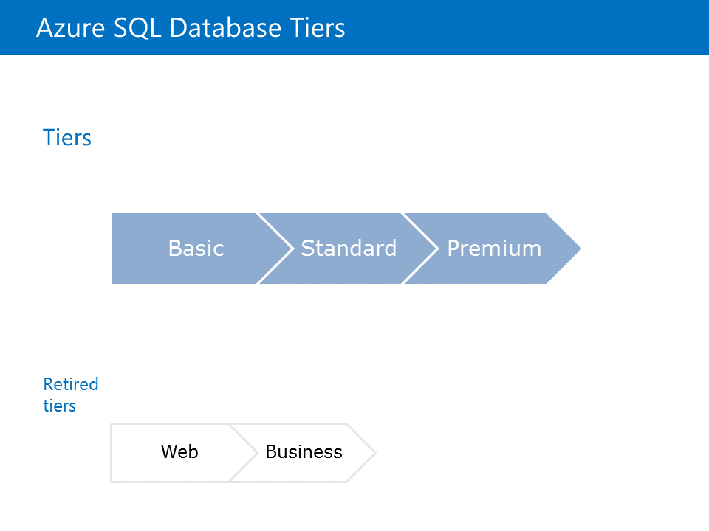
Module 4 Continued. . .
Azure SQL Database Overview > Azure SQL Database Tiers
The SQL Database service is offered in several tiers. You can select a tier that closely matches your application’s intended or actual resource needs. The following is a list of SQL Database service tiers with the associated performance characteristics:

Slide 11
Module 4 Continued. . .
Azure SQL Database Overview > Azure SQL Database Tiers
Basic: Ideal for simple databases that requires only a single connection performing a single operation at a time.
Standard: The most common option and is used for databases that require multiple concurrent connections and operations.
Premium: Designed for applications that require large quantities of transactions at volume. These databases support a large quantity of concurrent connections and parallel operations.

Slide 12
Module 4 Continued. . .
Azure SQL Database Overview > Azure SQL Database Tiers
These tiers are further separated into performance levels. Performance levels are very specific categories within a service tier that provides a specific level of service. For example, the P1 performance level in the Premium tier offers a maximum database size of 500 gigabyte (GB) and a benchmarked transaction rate of 105 transactions per second.

Slide 13
Module 4 Continued. . .
Azure SQL Database Overview > Azure SQL Database Tiers
Database Throughput Unit (DTU) are used to describe the capacity for a specific tier and performance level. DTUs are designed to be relative so that you can directly compare the tiers and performance levels. For example, the Basic tier has a single performance level (B) that is rated at 5 DTU. The S2 performance level in the Standard tier is rated at 50 DTU. This means that you can expect ten times the power for a database at the S2 performance level than a database at the B performance level in the Basic tier.

Slide 14
Module 4 Continued. . .
Azure SQL Database Overview > Azure SQL Database Tiers
Tiers and Performance Levels
Every tier has one or more performance levels. In general, the performance levels in the Premium tier are rated higher than the performance levels in the Standard tier, which are again rated higher than the Basic tier. The following chart illustrates this distinction.

Slide 15
Module 4 Continued. . .
Azure SQL Database Overview > Databases as a Service vs. SQL Server in a Virtual Machine
Databases as a Service vs. SQL Server in a Virtual Machine
SQL Database will always be compared with SQL Server Standalone that is hosted on a physical or virtual machine. With the SQL Database service, the majority of administration tasks are managed entirely by Microsoft. In scenarios where you require the ability to perform very unique and custom configuration, analysis, or administration, you can always host the SQL Server standalone product in a virtual machine in the Azure IaaS platform.

Slide 16
Module 4 Continued. . .
Azure SQL Database Overview > Databases as a Service vs. SQL Server in a Virtual Machine
Hosting Data in SQL Database
This solution is ideal for new applications that are based on cloud technologies, where requirements dictate that you do not need to customize the behavior of SQL Server. Many applications use SQL Server for storage, programmatic functionality, and basic query operations.
The databases that are stored in SQL Database are constrained by size. Solutions such as Elastic Scale are available to scale databases across multiple instances of different tiers.

Slide 17
Module 4 Continued. . .
Azure SQL Database Overview > Databases as a Service vs. SQL Server in a Virtual Machine
Hosting Data in SQL Server Standalone in a Virtual Machine in Azure
This solution is highly compatible with existing SQL applications that are hosted in an on-premises location. You can migrate the installation of SQL Server from an on-premises location to Azure by uploading the virtual hard disks. Because of this, you can use this solution in scenarios where you want to migrate your existing database workload without modifying it.

Slide 18
Module 4 Continued. . .
Azure SQL Database Overview > Databases as a Service vs. SQL Server in a Virtual Machine
Existing applications with a customized SQL installation benefit from using SQL Server Standalone on a virtual machine in Azure. For example, SQL Server Analysis Services (SSAS) is not available for the SQL Database service. If you host SQL Standalone on a virtual machine in Azure, you can enable the services that are used with SSAS.
If you want to enable a resilient scenario for your data, you have to manually configure SQL Server AlwaysOn.

Slide 19
Module 4 Continued. . .
Azure SQL Database Overview > Databases as a Service vs. SQL Server in a Virtual Machine
One of the most common reasons for hosting SQL Server standalone in Azure is for lift and shift scenarios. Lift and shift workloads are applications that are migrated from one platform to another with minimum changes to the application’s source code or configuration. Migrating an existing SQL workload to Azure IaaS is much easier to accomplish than migrating your application to SQL Database.

Slide 20
Module 4 Continued. . .
Azure SQL Database Overview > Databases as a Service vs. SQL Server in a Virtual Machine
After you migrate, you can analyze your existing SQL workload and determine the degree of compatibility with SQL Database. For new (greenfield) applications, SQL Database provides a near-zero maintenance experience that can accelerate the time to market for the newly created applications.

Slide 21
Module 4 Continued. . .
Azure SQL Database Overview > DAzure SQL Database v12
VIDEO

Slide 22
Module 4 Continued. . .
Managing SQL Databases in Azure > Overview
Overview
The Management Portal provides convenient ways to create and manage databases. There is also a unique portal that you can use to manage the tables, views, and other objects for your SQL database.
This module lists the various online management tools that are available for interacting with SQL databases in Azure.

Slide 23
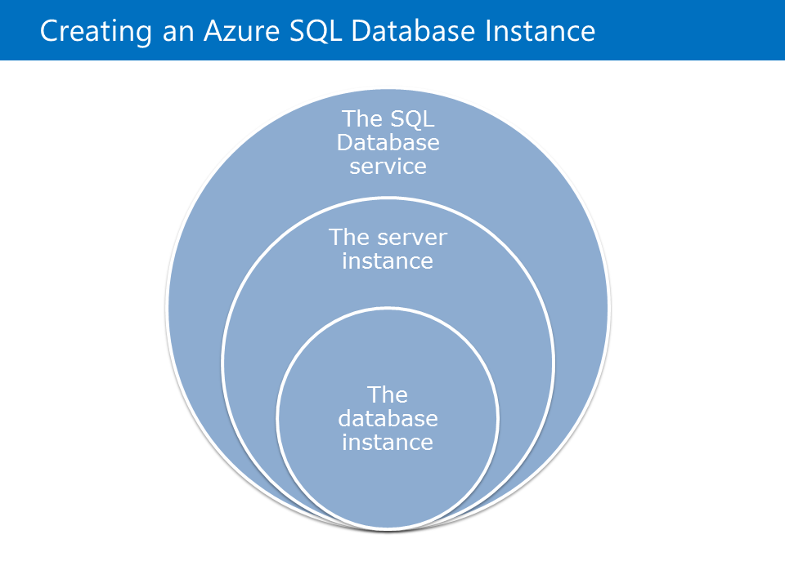
Module 4 Continued. . .
Managing SQL Databases in Azure > Creating an Azure SQL Database Instance
You can create a new database instance in the SQL Database service by using the portals, Service Management REST API, Windows PowerShell, or Visual Studio 2013.

Slide 24
Module 4 Continued. . .
Managing SQL Databases in Azure > Creating an Azure SQL Database Instance
. . . Before creating a database instance, you must create a logical server. This server must have a globally unique name which will be used to connect to the databases by using the TDS protocol. The server will have an administrator account created by using SQL Server authentication. Windows authentication is not currently supported. After you create the logical server, you can create database instances within the service. Database names do not need to be globally unique.

Slide 25
Module 4 Continued. . .
Managing SQL Databases in Azure > Creating an Azure SQL Database Instance
Creating New Databases by Using the Management Portal
To logically group your databases, you can create a server by using the Management Portal.
You also can create databases by using through the Management Portal. When you create a database, you can place it in an existing server or create a new server.

Slide 26
Module 4 Continued. . .
Managing SQL Databases in Azure > Creating an Azure SQL Database Instance
Management Portal – SQL Database
A unique Silverlight-based portal for your SQL Database instances is available in the current Management Portal. You can use this portal to view some simple analytical data for your databases and to manage database objects either visually or through T-SQL queries.

Slide 27
Module 4 Continued. . .
Managing SQL Databases in Azure > Managing Azure SQL Database Instances
VIDEO

Slide 28
Module 4 Continued. . .
Azure SQL Database Tools > Overview
One of the advantages of SQL databases in Azure is the ability to use many monitoring tools that you use for on-premises databases.
This module describes the existing management tools and how you can use them to manage SQL databases in Azure.

Slide 29
Module 4 Continued. . .
Azure SQL Database Tools > Azure SQL Database Tooling
VIDEO

Slide 30
Module 4 Continued. . .
Azure SQL Database Tools > SQL Server Management Studio
One of the greatest benefits of using the TDS protocol is that it provides many tools for connecting to SQL databases and servers. Because the protocol is fully supported by the SQL Database service, the client tools and applications do not need to be concerned about the actual architectural implementation. This enables scenarios where you can use a local SQL installation (such as LocalDb) for development and testing a SQL database for production. You can make this transition by swapping connection strings as appropriate.

Slide 31
Module 4 Continued. . .
Azure SQL Database Tools > SQL Server Management Studio
Setup
When you configure your SQL Database server instance, you are required to specify a user name and password. This login is the server-level principle for your SQL Database server. The login is similar to the sa principal in SQL Server Standalone. At any time you can use the master database that is created with your server to manage logins and roles for your databases.

Slide 32
Module 4 Continued. . .
Azure SQL Database Tools > SQL Server Management Studio
You can create additional logins by using standard T-SQL queries.
You can use the CREATE LOGIN, ALTER LOGIN, or DROP LOGIN statements to manage logins in SQL Database.
Managing Logins
CREATE LOGIN login1 WITH password='<ProvidePassword>';

Slide 33
Module 4 Continued. . .
Azure SQL Database Tools > SQL Server Management Studio
After you configure your server, you must also configure:
Firewall. You can configure the firewall to allow access to your SQL database from a pre-defined list of IP address ranges. Any IP address that is not included in these ranges will not be able to connect to the TDS endpoint.
Azure Service Access. You can configure a Boolean configuration option to indicate whether other Azure services can access the TDS endpoint of your SQL database.

Slide 34
Module 4 Continued. . .
Azure SQL Database Tools > SQL Server Management Studio
. . . Visual Studio provides several ways to manage SQL Server standalone and SQL Database instances. You can use the Server Explorer pane to connect to and manage a SQL database. You also can use the Server Explorer pane to manage various Azure services including SQL Database. You can use the SQL Server Object Explorer to manage both individual databases and an entire server. You can use Visual Studio database projects to design a database in a declarative way and publish the resulting script.

Slide 35
Module 4 Continued. . .
Azure SQL Database Tools > SQL Server Management Studio
SQL Server Management Studio
A TDS endpoint is exposed for each logical server in SQL Database. This allows you to use SQL Server Management Studio with SQL Database in the same way you will use it with SQL Server standalone.

Slide 36
Module 4 Continued. . .
Azure SQL Database Tools > Migration Tools
SQL Migration Scripts
You can generate migration scripts by using the Generate Scripts task in SQL Server Management Studio.
You can copy the script file that is generated to the Clipboard, open it in a script window, or save it to a file.
A simple method that is highly compatible with different versions of SQL Server.

Slide 37
Module 4 Continued. . .
Azure SQL Database Tools > Migration Tools
Importing and Exporting Data-Tier Applications
You can export the data-tier applications from a SQL database and import them into another.
A data-tier application contains the definitions of the objects in the database.
The application package also contains the data that is stored in the different database objects.
You can import data-tier applications into a SQL database in Azure.

Slide 38
Module 4 Continued. . .
Azure SQL Database Tools > Migration Tools
SQL Server Integration Services (SSIS)
You can use SSIS to both plan and perform migration of data from a SQL Server standalone installation to a SQL database in Azure. This is ideal for scenarios where the existing database uses the functionality that is not supported in the SQL Database service. You can migrate or remap the schema and data into a set of objects that can be hosted in the managed service.

Slide 39
Module 4 Continued. . .
Azure SQL Database Tools > Migration Tools
Microsoft Azure SQL Database Migration Wizard
This migration wizard, also known as SQLAzureMW, is designed to analyze existing databases and eventually perform a migration to SQL Database. The tools support a large range of SQL versions starting from SQL Server 2005. The actual migration is performed by generating a script to replicate the schema in SQL Database, and then using the BCP utility to copy the data to the destination from the data files that are exported from the origin.

Slide 40
Module 4 Continued. . .
Azure SQL Database Tools > Migration Tools
Azure Websites Migration Assistant
The Azure Websites Migration Assistant is designed to migrate IIS applications from on-premises to Azure. This tool also migrates SQL databases that are associated with the IIS website by using connection strings. The migration is performed by generating scripts using SQL Server Management Objects.

Slide 41
Module 4 Continued. . .
Securing and Recovering an Azure SQL Database Instance > Overview
Both SQL Server standalone and SQL Database offer a comprehensive set of replication and disaster recovery options.
This module describes the high availability features for both SQL Server standalone and SQL as a Service in Azure.

Slide 42
Module 4 Continued. . .
Securing and Recovering an Azure SQL Database Instance > Recovery Options for Azure SQL Database
Recovery Options for Azure SQL Database
Business continuity describes the planning and execution of maintaining running business operation when an unforeseen event occurs. Azure SQL Database offers many business continuity features with your databases that you would normally have to plan, design and implement. The Azure SQL Database infrastructure also uses replication to implement basic failover for your application within its own infrastructure.

Slide 43
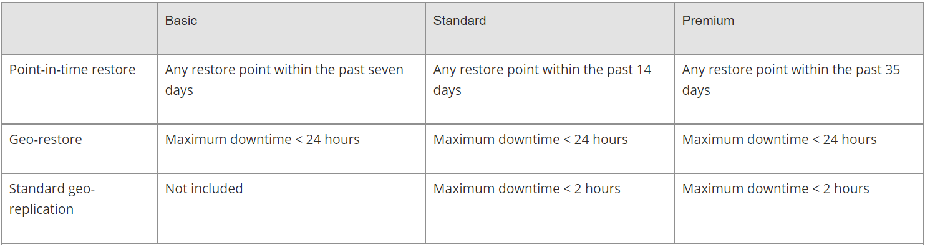
Module 4 Continued. . .
Securing and Recovering an Azure SQL Database Instance > Recovery Options for Azure SQL Database
There are three primary recovery options available for SQL Database.

Slide 44
Module 4 Continued. . .
Securing and Recovering an Azure SQL Database Instance > Recovery Options for Azure SQL Database
Point-in-Time Restore
Point-in-time restore returns your database and its data to an earlier point in time. The tier of your database determines how far back you can restore your database.

Slide 45
Module 4 Continued. . .
Securing and Recovering an Azure SQL Database Instance > Recovery Options for Azure SQL Database
Database Copy
The database copy feature creates a one-time copy of your database to a new instance in another datacenter. When the operation is complete, the duplicate database is transactionally consistent with the source database. Further transactions against the source database are not copied.

Slide 46
Module 4 Continued. . .
Securing and Recovering an Azure SQL Database Instance > Recovery Options for Azure SQL Database
The Import and Export Service
This service allows you to create a copy of your database in the .BACPAC format. This file contains a copy of both the data and schema of a database. This file can then be used to import a database into any other Azure SQL Database instance or a SQL Server installed standalone on a machine.

Slide 47
Module 4 Continued. . .
Securing and Recovering an Azure SQL Database Instance > Recovery Options for Azure SQL Database
Geo-Restore
Geo-restore behaves in a similar manner to point-in-time restore. The primary difference is that geo-restore replicates the database to a datacenter in another region. Geo-restore is typically used when there is an outage in a specific Azure region.

Slide 48
Module 4 Continued. . .
Securing and Recovering an Azure SQL Database Instance > Recovery Options for Azure SQL Database
Standard Geo-Replication - Geo-replication automates the failover of you primary SQL Database instance to another region. The replica created is not available and cannot accept queries or incoming connections using the TDS endpoint. All transactions to your primary database are replicated to the secondary in an asynchronous manner. In the event of an outage, the primary database is flagged as having degraded service. You can then use automation or application logic to connect to your secondary database.

Slide 49
Module 4 Continued. . .
Securing and Recovering an Azure SQL Database Instance > Recovering an Azure SQL Database Instance
VIDEO

Slide 50
Module 4 Continued. . .
Securing and Recovering an Azure SQL Database Instance > Azure SQL Databases Geo-Replication
Active Geo-replication
Out-of-the-box, active geo-replication offers the same functionality as standard geo-replication for a simple failover scenario. Active geo-replication goes even further and can maintain up to four copies of your database that are replicated in a synchronous (continuous) manner. The secondary databases are readable so that your data is still available in an uninterrupted manner while you conduct your failover orchestration.

Slide 51
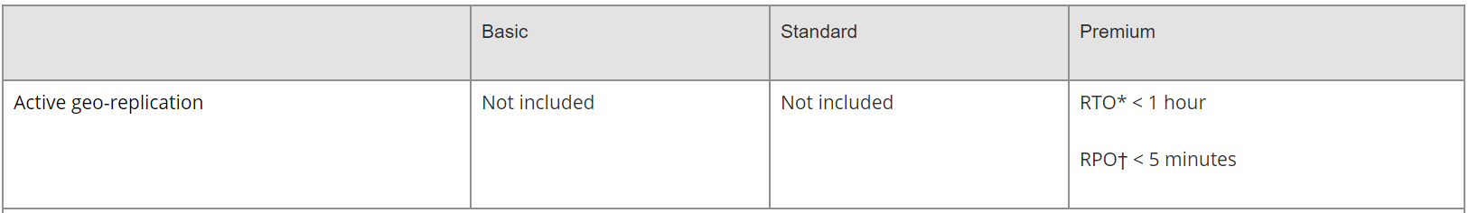
Module 4 Continued. . .
Securing and Recovering an Azure SQL Database Instance > Azure SQL Databases Geo-Replication
Active Geo-replication

Slide 52
Module 4 Continued. . .
Securing and Recovering an Azure SQL Database Instance > Geo-Distributed SQL Applications
VIDEO

Slide 53
Module 4 Continued. . .
Lab: Storing Event Data in Azure SQL Databases
Lab: Storing Event Data in Azure SQL Databases

